Slide 1
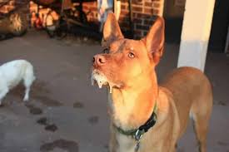
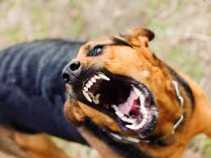
RABIES

Slide 2
Epidemiology
Acute rapid progressive & highly fatal viral disease of CNS caused by Lyssavirus type 1.
Zoonotic disease of warm blooded animals (dogs, cats , bats, racoons, skunks, foxes )
Transmitted to man by bite of rabid animal.
Non-bite exposures : aerosols; generated in labs , caves with bats , corneal transplantation.
Human to human transmission extremely rare.
Worldwide endemic canine rabies : 55,000 deaths annually ( India alone 20,000 )
Louis Pasteur and Emile Roux first developed rabies vaccine in 1885.

Slide 3
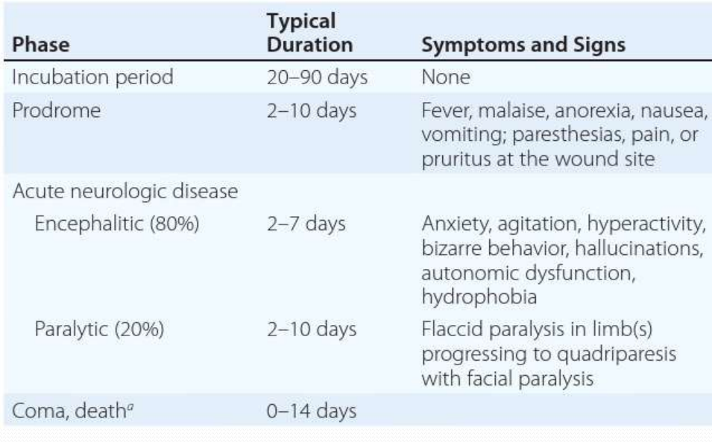

Slide 4
Treatment
No established treatment.
Isolation in quiet room ( as bright light , noise , cold draughts precipitates spasms / convulsions)
Sedatives to relieve anxiety.
Hydration.
Intensive respiratory & cardiac support

Slide 5
Prevention
Health personnel should wear face masks, gloves, goggles, & aprons (saliva, vomits, tears, urine or other body fluids of rabies patient contain virus )
Persons having bruises , cut or open wounds not entrusted to look after patient.
Pre-exposure prophylaxis.
Post exposure prophylaxis.

Slide 6
Post Exposure Prophylaxis
Local wound care ( all bite wounds/scratches washed with soap and water ) reduces chances up to 80%.
Devitalised tissues debrided.  Tetanus prophylaxis given.
Suturing delayed( if necessary done after 24-48 hours later )
Antibiotic treatment whenever indicated.
Active immunisation by Rabies vaccine.
Passive immunisation by Human Rabies Immuno Globulins (HRIG )

